Slide 1


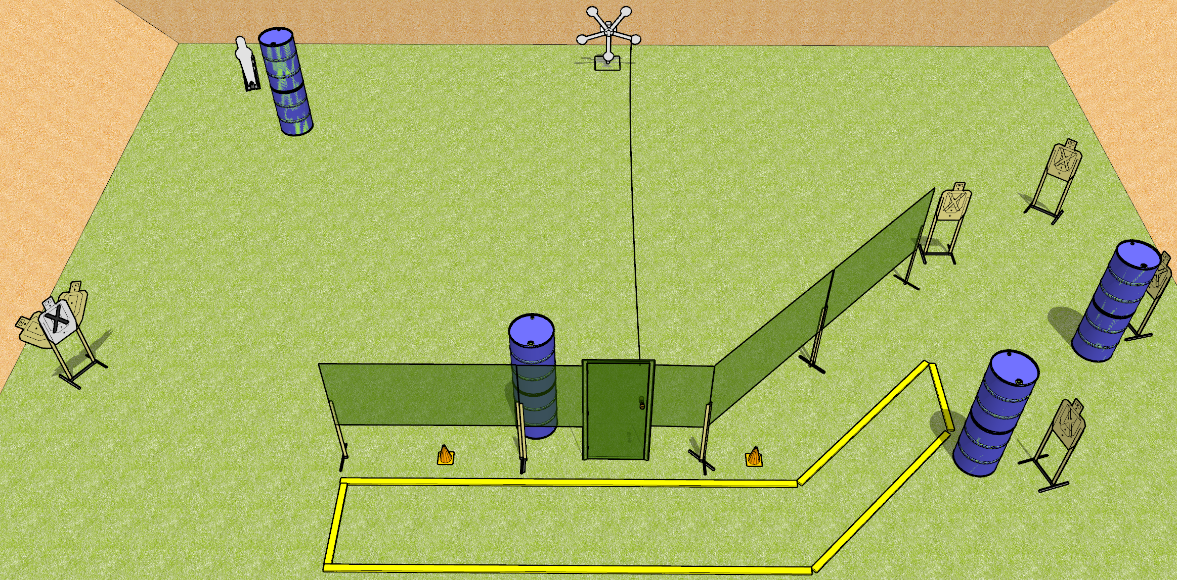
 | Dothan Gun Club – USPSA Match Reach for the Star Course Designer : Drew Coleman
START POSITION : Standing with both heels anywhere on the rearmost fault line, inside the shooting area
GUN READY CONDITION : Pistol loaded and holstered. PCC shouldered, safety on, pointed at either orange cone |  | SCORING: Comstock, 18 rounds TARGETS: 6 paper, 6 Steel SCORED HITS: Best 2 on paper, steel until down START-STOP: Audible, last shot RULES:
STAGE PROCEDURE: Engage targets as they become available from within the fault lines.

